Slide 1
Produto conceito apresenta:
“FTFS - Bar Maker”
Grupo 06:
- Camilly
- Eduarda
- Gabriel
- Rafael
- Samuel

Slide 2
O que faz?
Nosso produto processa alimentos selecionados trasformando em uma barra proteica comprimida contendo os nutrientes necessarios para uma refeicao completa.

Slide 3
Como funciona?
01
02
02
Identifica
Comprime
Através de sensores, os alimentos são identificados e selecionados.
01
Por meio de vácuo compreensão o conteúdo e reduzido e minimizado.
03
04
03
04
Processa
Finalizacao
Por meio de nano robôs o conteúdo e delicadamente processado e harmonizado.
Por fim, através de um software automatizado, o conteúdo esta pronto.

Slide 4
Manuseio
Ingredientes
Preparo
Separe os alimentos desejados, lave e descasque.
Especifique os nutrientes desejados e aguarde.
Processamento
Consume
Coloque dentro dos compartimento e selecione o modo desejado.
Informe o modo de consumo e proveite!

Slide 5
Beneficios
01
Energia
Tenha disposicao
04
Praticidade
02
Ganhe tempo
Tempo
Uma refeicao rapida
05
Controle
03
Tenha uma dieta nutritiva e equilibrada
Saude
Supra todas suas necessidades

Slide 6
Publico alvo
Pessoas com pouco tempo que buscam uma alimentacao equilibrada e nutritiva capaz de suprir tudas as suas necessidades.

Slide 7
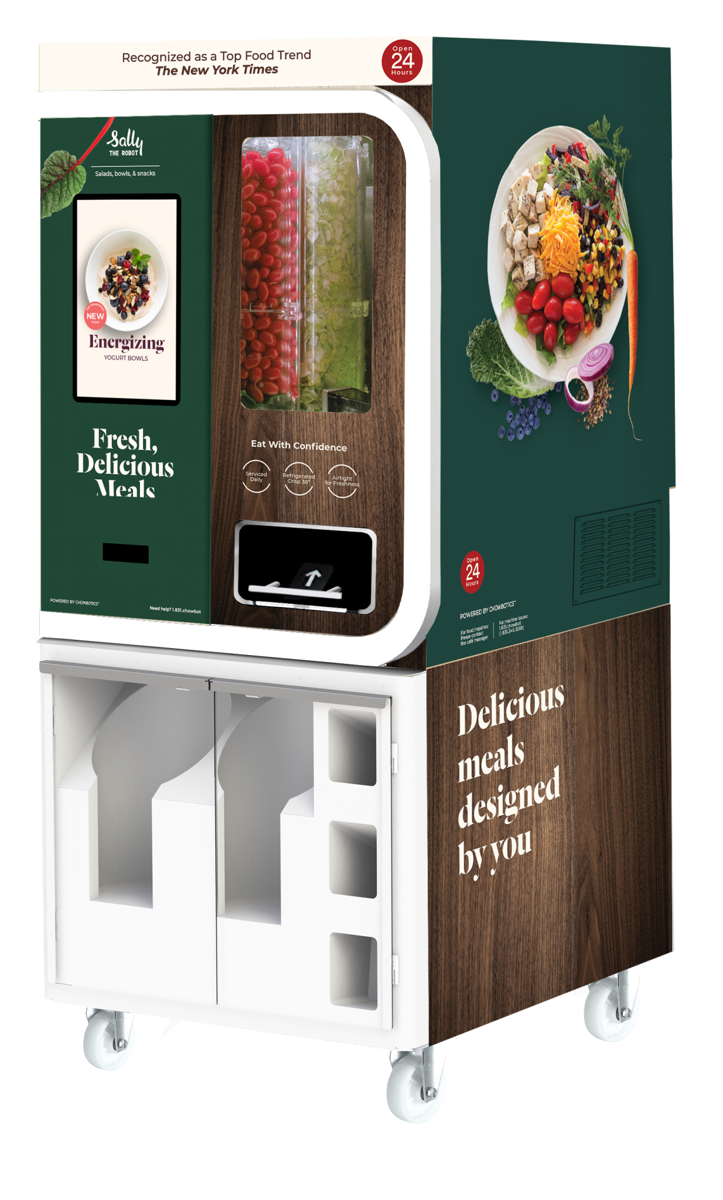
Industrial Production Infographics
Mercury
Jupiter
Mercury is the closest planet to the Sun
It’s a gas giant and the biggest planet
Mars
Venus
Despite being red, Mars is a cold place
Venus is the second planet from the Sun
Jupiter
Saturn
It’s a gas giant and the biggest planet
Saturn is the ringed one. It’s a gas giant

Slide 8
Design Industrial
Variedade
Controle
Acessibilidade
Ecologico
Economico
Leve

Slide 9
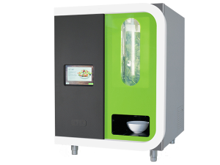
Design Portatil
01
02
Portabilidade
Praticidade
Modelo pratico para uso domestico.
Facil de usar, configurar e limpar.
04
03
Slim model
Acessibilidade
Design minimalista e moderno.
Mercury is the closest planet to the Sun and the smallest one

Slide 10
Industrial Production Infographics
Project Process
Venus has a beautiful name and is the second one from the Sun
Jobbing Process
Mercury is the closest planet to the Sun and the smallest one
Labor Management
Despite being red, Mars is a cold place full of iron oxide dust
Quality Management
Jupiter is a gas giant and the biggest planet in the Solar System

Slide 11
Industrial Production Infographics
Mars
01
Despite being red, Mars is a cold place. It’s full of iron oxide dust, which gives the planet its reddish cast
Mercury
02
The closest planet to the Sun and the smallest one in the Solar System—it’s only a bit larger than our Moon
Jupiter
03
It’s a gas giant and it’s the biggest planet in the Solar System. Jupiter is the fourth-brightest object in the sky

Slide 12
Industrial Production Infographics
01
Venus has a beautiful name and is the second one from the Sun
02
Mercury is the closest planet to the Sun and the smallest one
03
Despite being red, Mars is a cold place full of iron oxide dust
Venus
Mercury
04
Mars
Jupiter
It’s a gas giant and the biggest planet in the Solar System

Slide 13
Industrial Production Infographics
01
Venus
Venus is the second planet from the Sun
02
Mars
Despite being red, Mars is a cold planet
03
Mercury
Mercury is the closest planet to the Sun
04
Saturn
It’s a gas giant and has several rings

Slide 14
Industrial Production Infographics
Jupiter
It’s a gas giant and the biggest planet
Venus
Venus has a beautiful name, but it’s very hot
Mars
Despite being red, Mars is a cold place
Neptune
This is the farthest planet from the Sun
Mercury
It’s the closest planet to the Sun

Slide 15
Industrial Production Infographics
Venus
Venus is the second planet from the Sun
Mars
Despite being red, Mars is a cold planet
Saturn
Saturn is a gas giant and has rings
Mercury
Mercury is the closest planet to the Sun

Slide 16
Industrial Production Infographics
01
02
02
02
Mass production
Just in time
Agile
Mass customization
Mercury is the smallest planet of them all
Saturn is a gas giant and has rings
Jupiter is the biggest planet of them all
Neptune is the farthest planet from the Sun

Slide 17
Industrial Production Infographics
Project Process
Venus has a beautiful name and is the second one from the Sun
01
02
Jobbing Process
Mercury is the closest planet to the Sun and the smallest one
Labor Management
Manufacturing Process
Despite being red, Mars is a cold place full of iron oxide dust
05
03
Quality Management
Jupiter is a gas giant and the biggest planet in the Solar System
04
Product Tracing
Neptune is the eighth planet and the farthest from the Sun

Slide 18
Industrial Production Infographics
Earth
Neptune
Mars
Mercury
Earth is the third planet from the Sun
It’s the farthest planet from the Sun
Despite being red, Mars is a cold place
It’s the closest object to the Sun

Slide 19
Industrial Production Infographics
Just in time
Mass customization
Saturn is a gas giant and has rings
Neptune is the farthest planet from the Sun
Mass production
Agile
Mercury is the smallest planet of them all
Jupiter is the biggest planet of them all

Slide 20
Industrial Production Infographics
Mercury
01
02
Saturn
Mercury is the closest planet to the Sun and the smallest one
It is the ringed planet. It is composed of hydrogen and helium
Jupiter
03
04
Mars
Jupiter is a gas giant and the biggest object in the Solar System
Despite being red, planet Mars is a very cold place

Slide 21
Industrial Production Infographics
01
03
Mercury
Saturn
Mercury is the closest planet to the Sun and the smallest one
It is the ringed planet. It is composed of hydrogen and helium
02
04
Jupiter
Mars
Jupiter is a gas giant and the biggest object in the Solar System
Despite being red, planet Mars is a very cold place

Slide 22
Industrial Production Infographics
Mass production
Just in time
Mercury is the smallest planet of them all
Saturn is the ringed planet from the Sun
Flexible
Mass customization
Neptune is the biggest planet of them all
Jupiter is the biggest planet of them all
Agile
Rapid
Venus has a very poisonous atmosphere
Despite being red, Mars is very cold

Slide 23
Industrial Production Infographics
Assembly
Customizing
Despite being red, Mars is a cold place
It’s a gas giant and the biggest planet
Production
Quality
Mercury is the closest planet to the Sun
Venus is the second planet from the Sun

Slide 24
Industrial Production Infographics
Manufacturing
Assembly
Coloring
Packing
Despite being red, Mars is a cold place
Mercury is the closest planet to the Sun
Venus is the second planet from the Sun
It’s a gas giant and the biggest planet

Slide 25
Industrial Production Infographics
Earth
Mercury
Earth is the third planet from the Sun
Planet Mercury is the closest object to the Sun
Neptune
Mars
Neptune is the farthest planet from the Sun
Despite being red, Mars is a cold place
Saturn
Jupiter
Saturn is composed of hydrogen and helium
Jupiter is a gas giant and the biggest planet

Slide 26
Industrial Production Infographics
Neptune
Earth
It’s the farthest planet from the Sun
It’s the third planet from the Sun
Jupiter
Mercury
Jupiter is the biggest planet of them all
It’s the closest planet of the Sun

Slide 27
Industrial Production Infographics
Mars
Mercury
Venus
It has a beautiful name and is the second planet
Manufacture
25%
50%
25%
It’s the closest planet to the Sun and the smallest
Assembly
30%
20%
50%
Despite being red, Mars is actually a cold place
Customize
35%
20%
45%

Slide 28
Industrial Production Infographics
01
Mercury is the closest planet to the Sun
Mercury
02
Venus is the second planet from the Sun
Venus
03
Jupiter is a gas giant and the biggest planet
Jupiter
Industrial Production
04
Yes, this is the ringed one. It’s a gas giant
Saturn

Slide 29
Industrial Production Infographics
Mars
Venus
Despite being red, Mars is a cold place. It’s full of iron oxide dust
Venus has a beautiful name and is the second planet from the Sun
Mercury
Jupiter
Mercury is the closest planet to the Sun and the smallest one
Jupiter is a gas giant and the biggest planet in the Solar System

Slide 30
Industrial Production Infographics
01
Jupiter is the biggest of them all
02
Mercury is the smallest planet
03
Venus has a nice name, but it’s hot
04
Saturn is a gas giant and has rings

Slide 31
Industrial Production Infographics
Mass production
Venus has a beautiful name and is the second one from the Sun
Just in time
Mercury is the closest planet to the Sun and the smallest one
Flexible
Despite being red, Mars is a cold place full of iron oxide dust
Agile
Jupiter is a gas giant and the biggest planet in the Solar System

